Slide 1


Restaurant Ratings
Delivery and Ratings Study

Slide 2




Research Question
Do restaurants that offer delivery services receive higher Yelp ratings than those that don’t?
Hypothesis:
H0: Restaurants that offer delivery have the same Yelp ratings as those that do not.
Ha: Restaurants that offer delivery have higher Yelp ratings than those that do not.

Slide 3
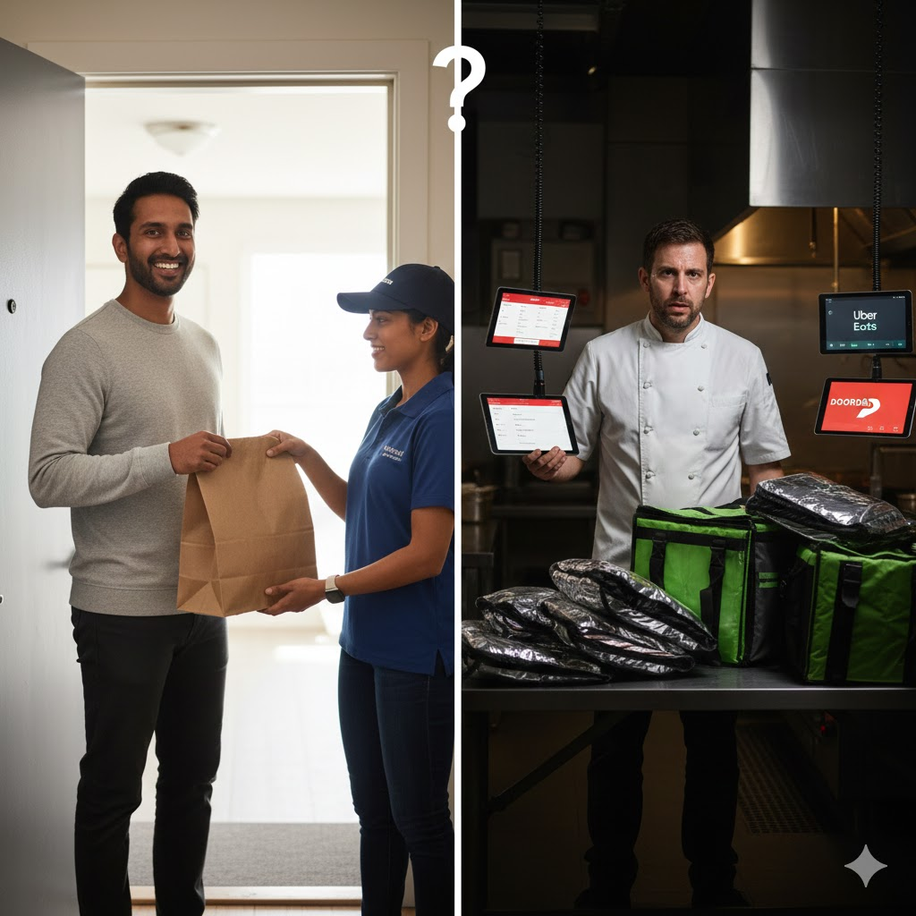
Motivation
The Delivery Market Dilemma
Post-COVID, food delivery has become a $100B+ industry (DoorDash, Uber Eats, Grubhub).
Why and to whom this matters?
Restaurant owners
Investors
The industry
Why Data Is Necessary?
The conventional wisdom is split:
Some argue delivery adds convenience and reaches new customers
Others warn it dilutes quality and increases operational complexity
We cannot answer this with anecdotes alone. We need empirical evidence.

Slide 4
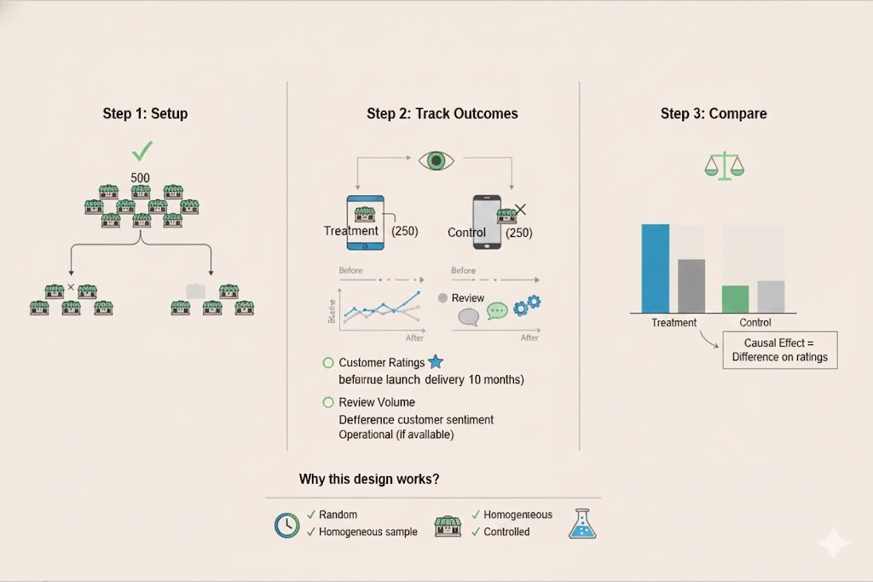
Ideal Experiment

Slide 5

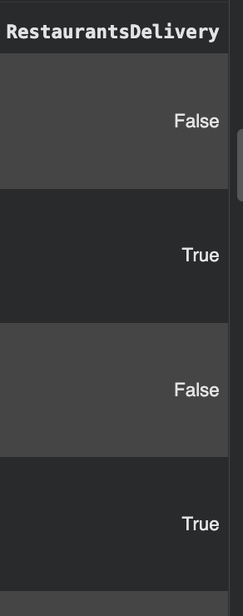
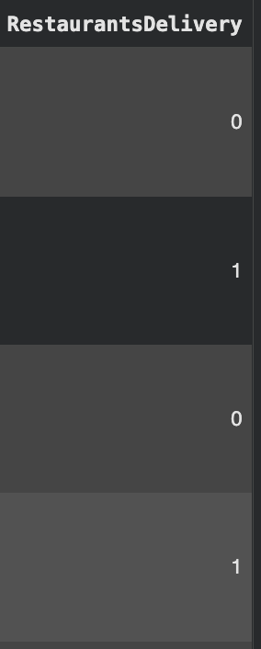
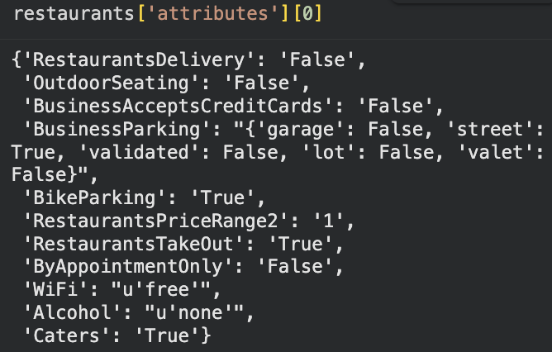
Data Description & Sturcture
restaurants.json from Yelp Open Data:
name
location
star rating
number of reviews
service attributes (e.g. whether the restaurant offers delivery)
2. Data Transformation

Slide 6
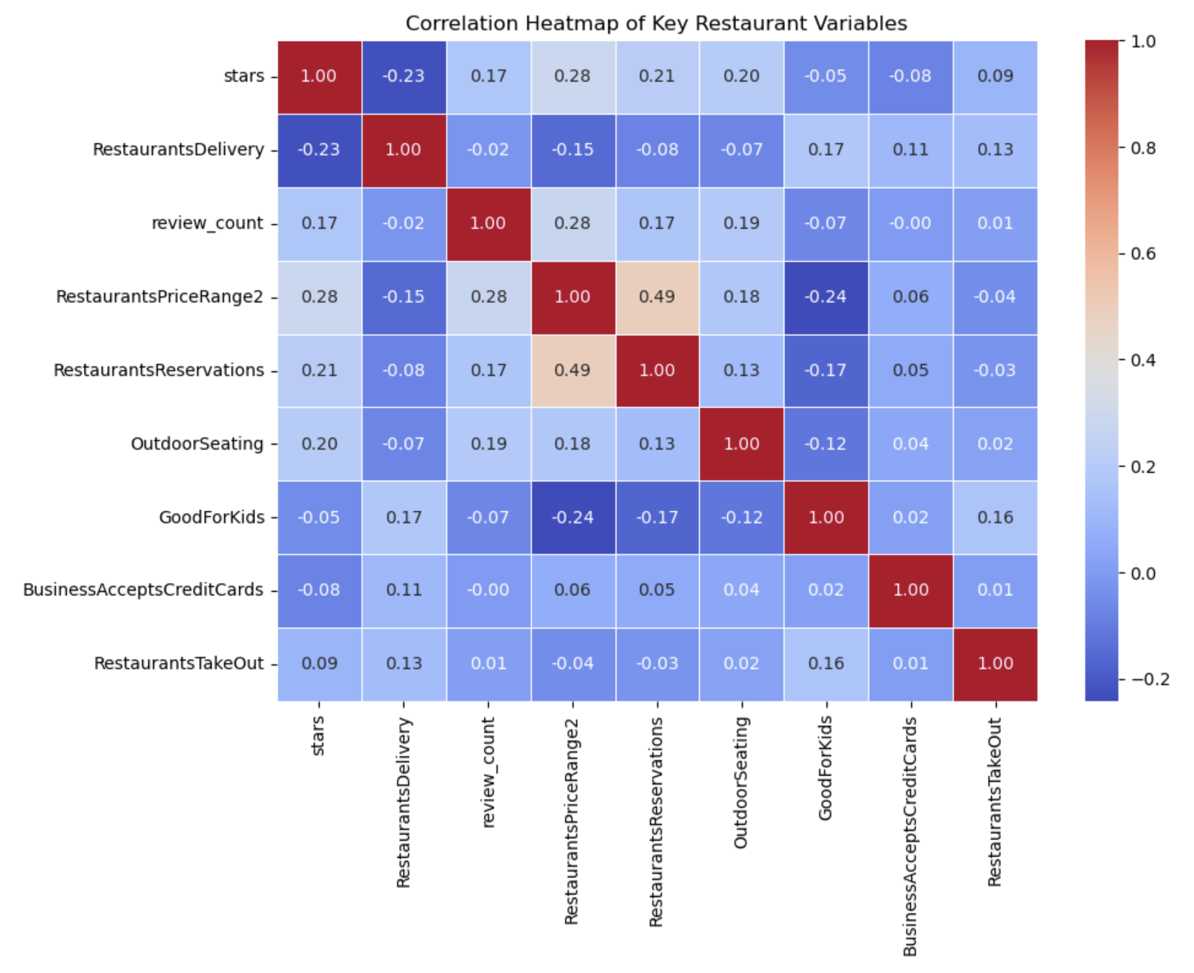
Data visualization
Restaurants Delivery (-0.23) is negatively correlated with ratings, indicating that offering delivery is associated with slightly lower customer ratings.
Restaurants Price Range (+0.28) shows the strongest positive correlation with ratings.
Restaurants Reservations (+0.21) and Outdoor Seating (+0.20) also show moderate positive relationships with ratings.
Besides the relationship with star ratings, Restaurant Reservations show a strong positive correlation (0.49) with Price Range, suggesting that more expensive restaurants are more likely to offer or require reservations.

Slide 7
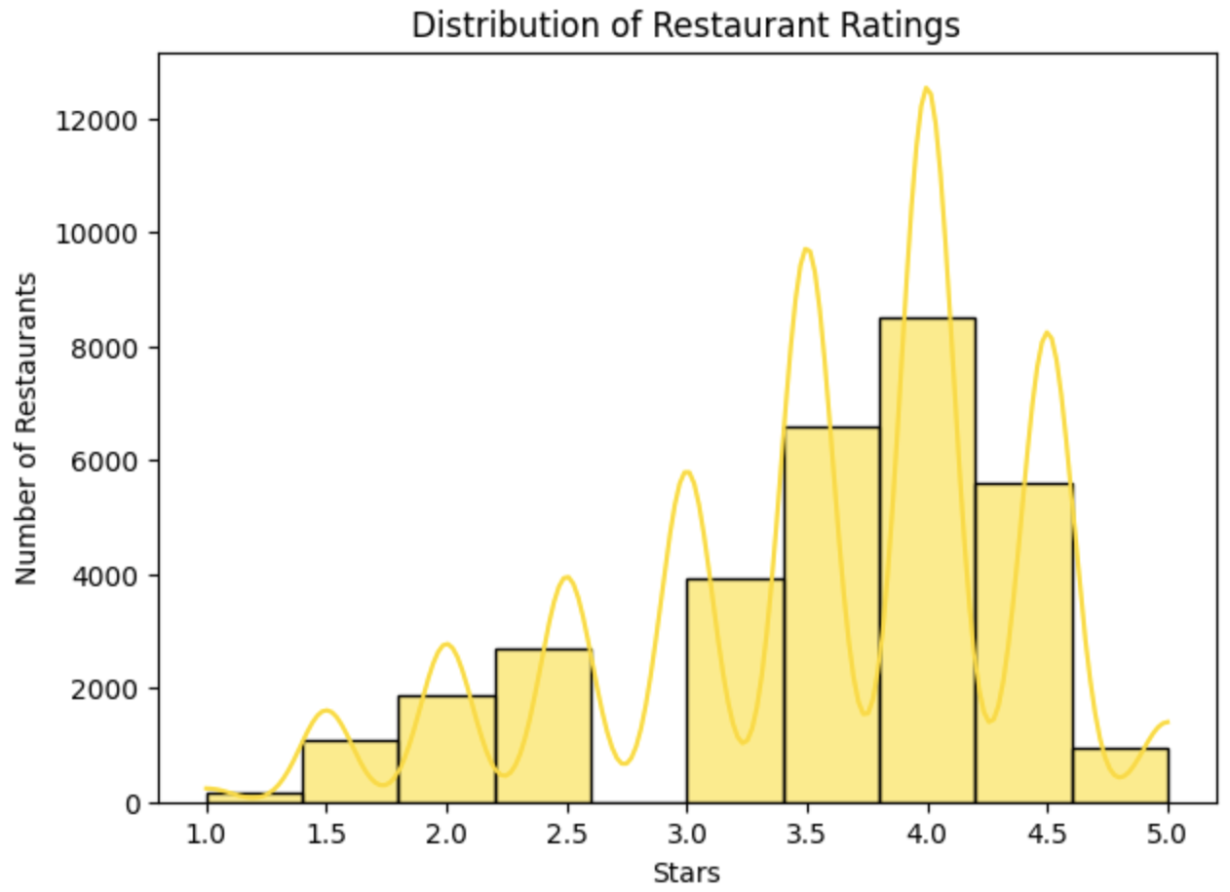
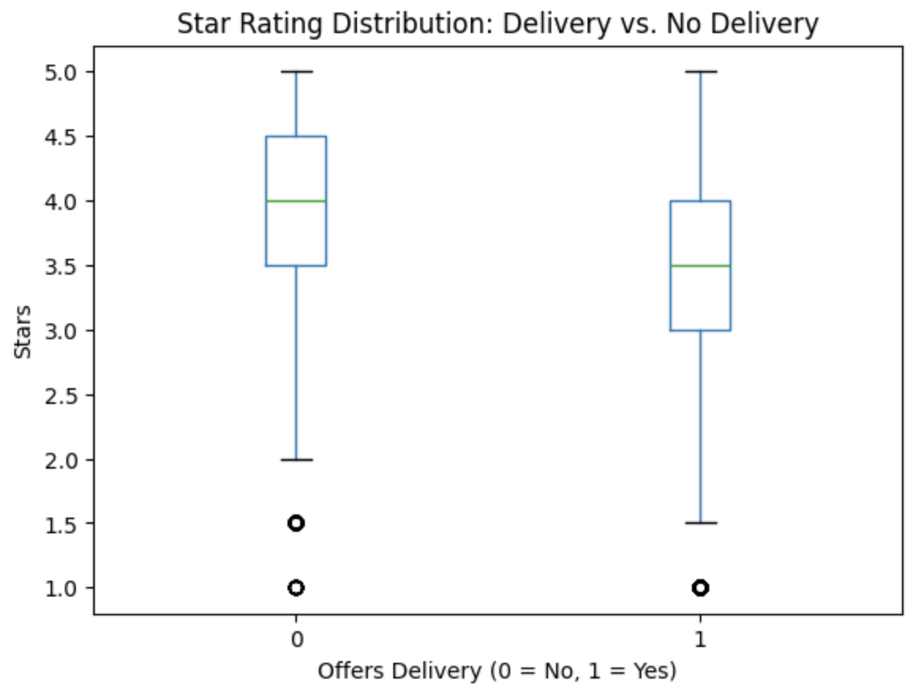
Rating vs Delivery Options (key variables)
Ratings skew high: Most restaurants receive above-average ratings between 3.5 and 4.5, with a peak at 4.0, indicating generally positive customer feedbacks.
Restaurants that don’t offer delivery tend to have slightly higher average and median ratings.
Those that offer delivery exhibit wider variance and more low-end outliers, suggesting inconsistency in customer experiences.
Delivery may introduce operational variability (e.g., delays, packaging, food temperature) that affects customer satisfaction and ratings.

Slide 8
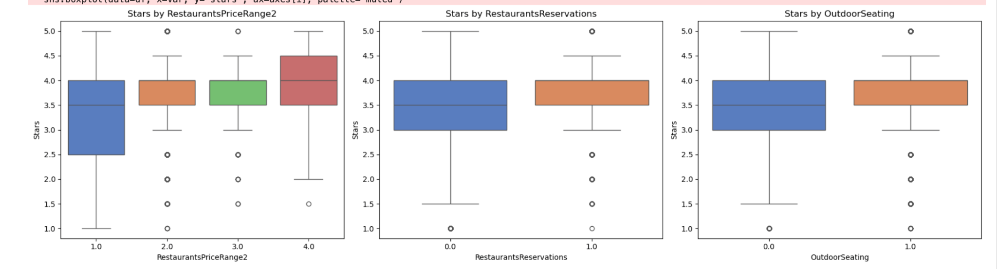
How other Variables Shape Restaurant Ratings
Price Range
Higher-priced restaurants (Price Range = 4) generally have higher star ratings and less variability.
In contrast, the lowest price tier (1) shows the widest spread, including many low ratings.
This suggests more expensive restaurants tend to offer more consistent quality or customer satisfaction.
Reservations
Restaurants that accept reservations tend to have slightly higher average star ratings than those that don’t.
This may reflect better service, organization, or customer experience.
Outdoor Seating
Restaurants with outdoor seating show higher median ratings than those without.
This could indicate that customers value ambiance and flexibility, especially post-pandemic.

Slide 9
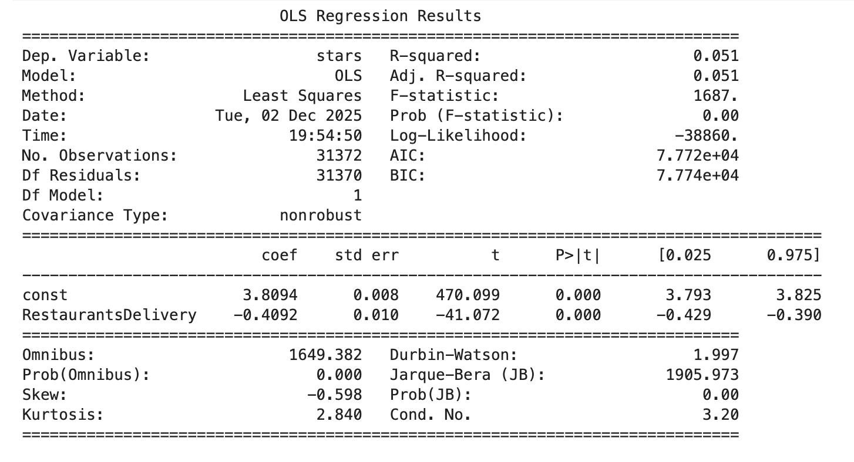
Simple Regression
R-squared = 0.051
This model predicts that on average, restaurants that offer delivery have Yelp ratings that are about 0.4 stars lower than the similar restaurants that do not offer delivery.

Slide 10
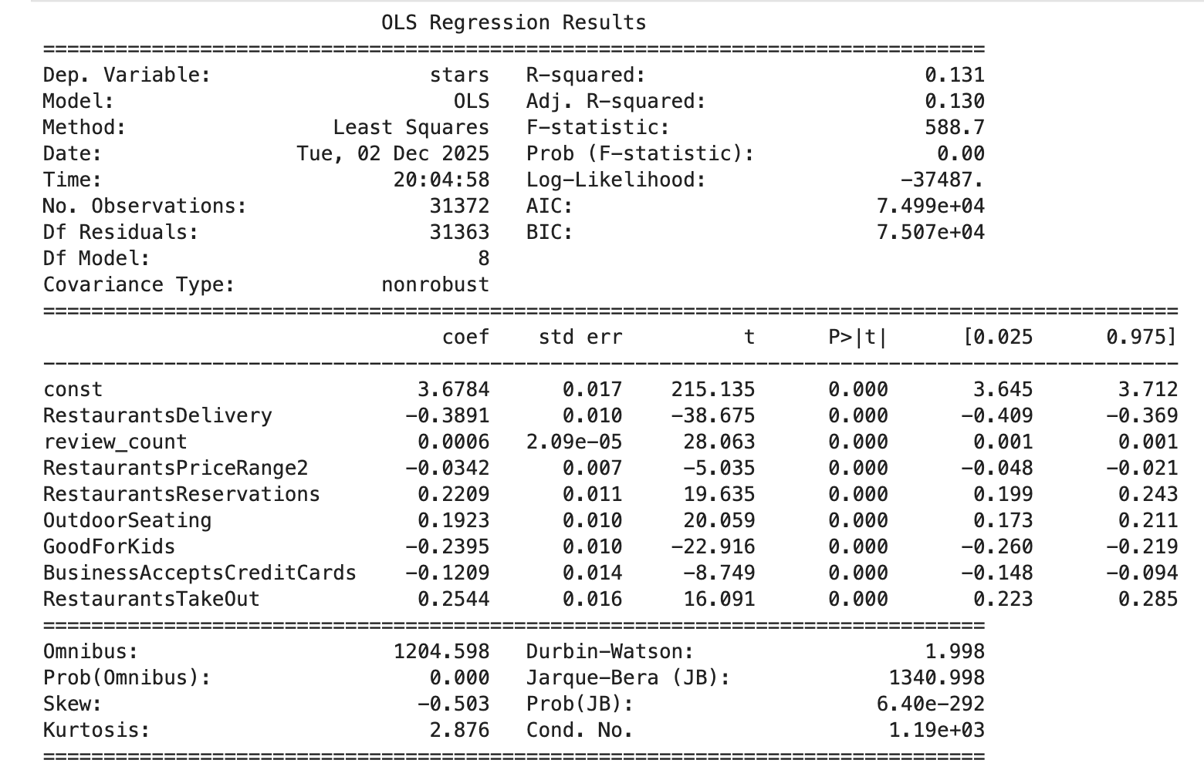
Multivariable Regression
R-squared = 0.131
On average, restaurants that offer delivery have Yelp ratings that are about 0.4 stars lower than the similar restaurants that do not offer delivery.
The result is against the hypothesis that offering delivery is associated with higher ratings
Notes:
if two restaurants are the same in terms of review count, price range, reservations, outdoor seating, kid-friendliness, credit card policy, and takeout availability, the one with delivery is predicted to score 0.39 fewer stars.

Slide 11
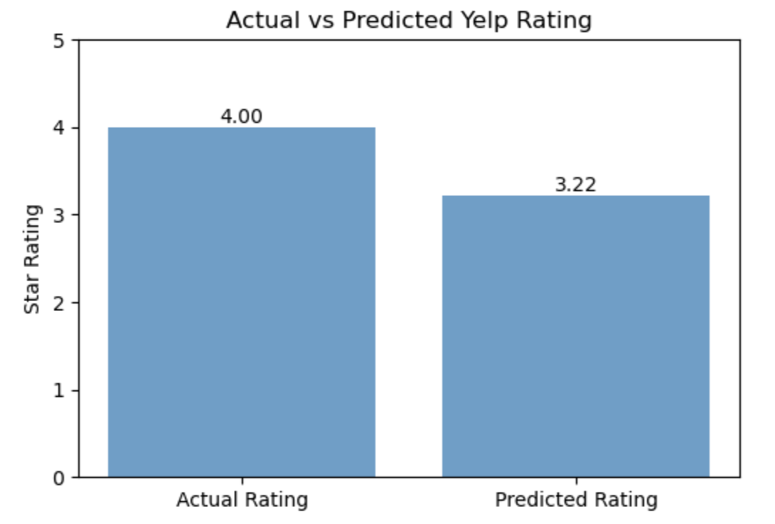
Prediction Case - Soco's Gyros
Soco’s Gyros Model Inputs
Offer delivery | 1
has 126 reviews | 126
most affordable | 1
no outdoor seatings | 0
no reservation | 0
good for kids | 1
accept credit cards | 1
offer takeouts | 1
95% Prediction Interval: [2.7, 4.8]

Slide 12

Summary & Key Takeaways
Key Findings
Delivery restaurants have lower ratings (–0.4 stars)
Delivery leads to more low and inconsistent reviews
Data and regression both show a clear negative effect
Other factors matter, but don’t remove the delivery impact
No evidence that delivery improves ratings
Implications
For Restaurants
Delivery boosts reach but may lower ratings
Packaging and consistency are important
For Consumers
Yelp scores may mix dine-in and delivery experiences
For Researchers
Compare Yelp vs delivery-platform ratings in future work

